Slide 1
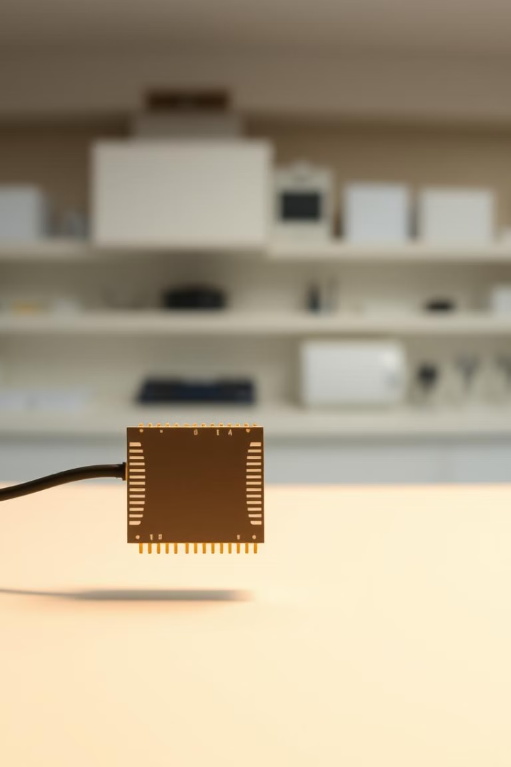

Microstrip Patch Antenna Design for Ku Band
This presentation details the design and simulation of a microstrip patch antenna, specifically for Ku band applications (12 GHz to 18 GHz), using CST Studio Suite software. The antenna is designed to operate at 18 GHz with high efficiency and optimal radiation characteristics.
by DEVASHISH TUSHAR
Notes:
1

Slide 2
Introduction to Micrstrip Patch Antennas
Compact Size
Low Cost
These antennas are compact and easy to integrate into modern devices.
The design process and fabrication of these antennas are cost-effective.
Notes:
2

Slide 3

Why Ku Band?
High-Speed Communication
Satellite Communications
1
2
Ku band frequencies allow for higher data rates and improved signal quality.
Ku band is widely used in satellite broadcasting and mobile services.
Notes:
3

Slide 4
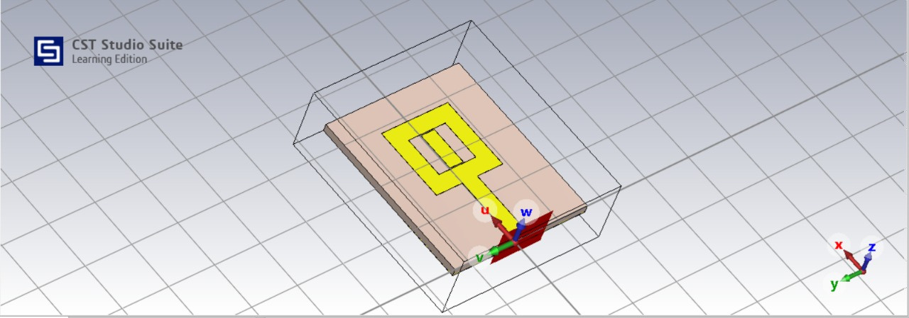
Design Methodology and Key Features
Square Slot Patch
Feeding Mechanism
Substrate Properties
A square slot patch with a vertical coupling strip is employed for band-notched functionality.
A 50-ohm microstrip line feeds the antenna, ensuring good impedance matching.
The antenna is fabricated on an FR4 substrate with a dielectric constant of 4.3 and a loss tangent of 0.02.
Notes:
4

Slide 5
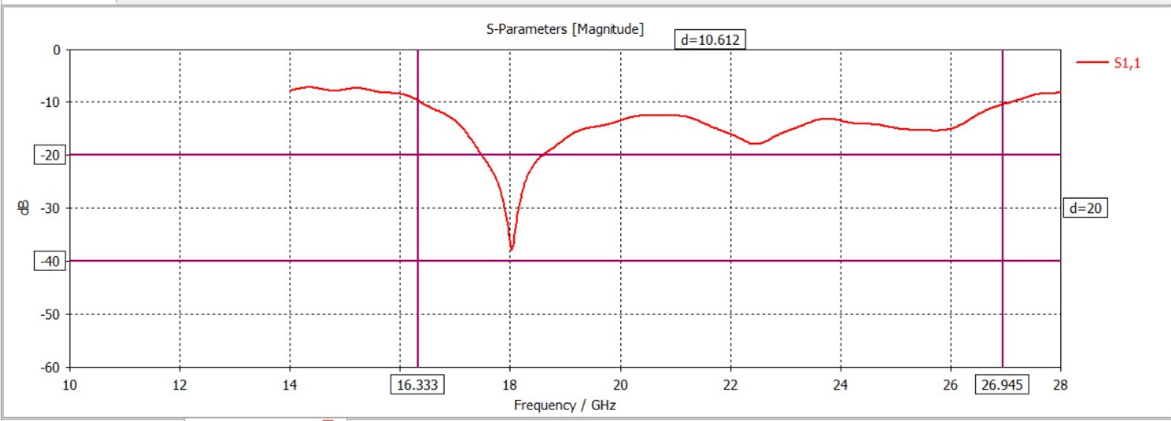
Simulation Results
S11
-37.30 dB at 18 GHz, indicating excellent impedance matching
Notes:
5

Slide 6
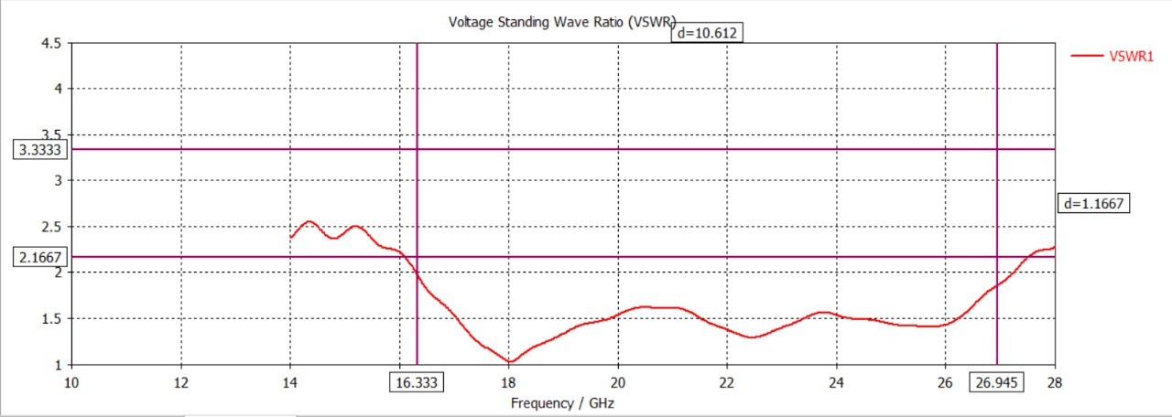
VSWR
1.037 at 18 GHz, ensuring efficient power transmission

Slide 7
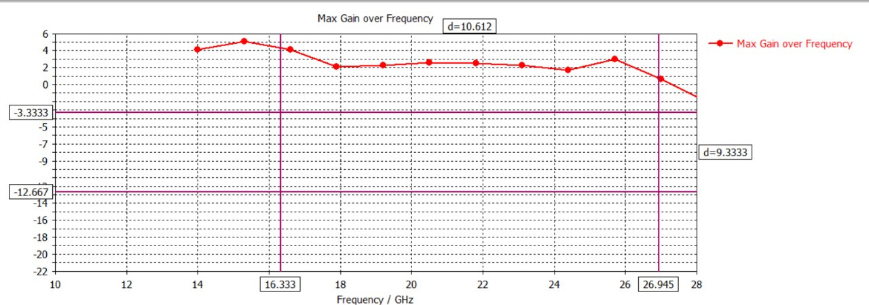
Gain
2.1 dB, providing reliable signal propagation

Slide 8
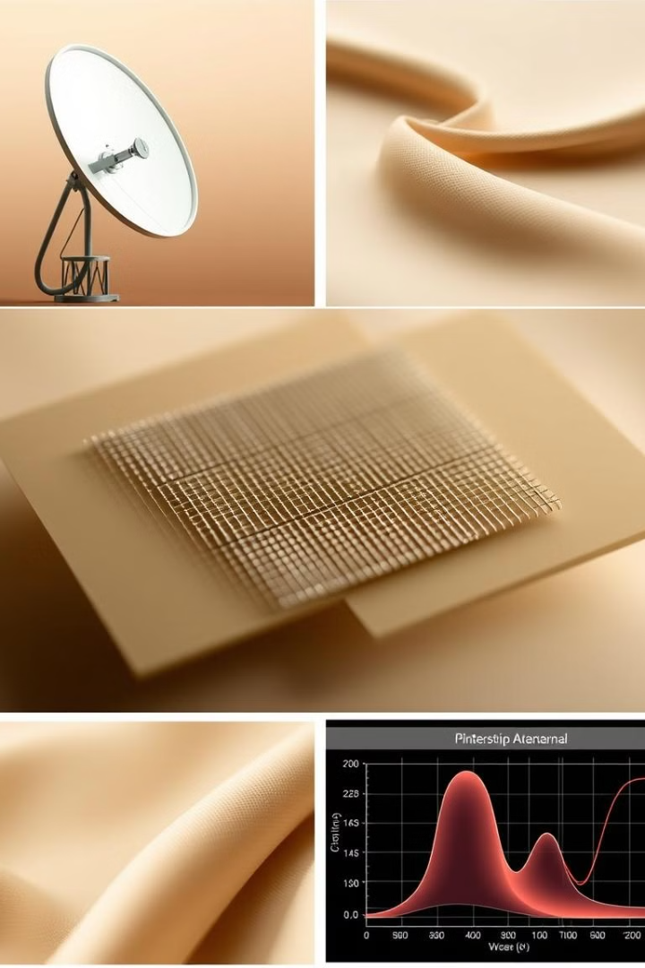

Conclusion
This project successfully demonstrates the potential of microstrip patch antennas in addressing the growing demands of high-frequency communication technologies. The compact design and high performance at 18 GHz make this antenna a viable solution for Ku band applications. The research highlights the importance of careful engineering and advanced simulation techniques in antenna design.
Notes:
6

